Slide 1
TDD — And Why You Should Bother
November 15th, 2019
Notes:
Opening slide.

Slide 2
Who Are We?
Notes:
Introduce Fiix the company, fiixsoftware.com
Introduce the presenter(s)
Introduce the other personnel
We’re here to run a coding challenge, but first we need to preface what exactly we’re challenging you with
Explain that everything we say and do in this challenge, we use daily at our office

Slide 3
Let’s Talk About Software
Software can be thought of as a collection of services
A service is a collection of features combined to achieve a purpose
A feature is a collection of functions combined to achieve a goal
A function is the smallest meaningful division of software
Notes:
By function, I don’t mean the programming definition of function, nor a method.
A function is a performable action.
Move away from thinking about software as code.

Slide 4
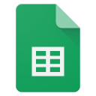
Ex: The File Menu in Google Sheets
Contains the following features:
Share
To where?
New:
Different file types of the Google Suite
Open
Open what?
Import Slides
Make a Copy
Rename
etc.
Notes:
Talk about the functions within each feature, such as how with open you have to click the open button, select a file from a modal, then click the open button

Slide 5


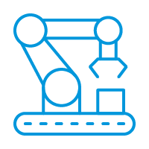
What is a Test?
A test is a repeatable activity to assert the validity of an expectation.
Manual Testing
(by yourself)
Outsourced Testing
(quality assurance)
Automated Testing
(tests as code)
Notes:
After stating the “technical” definition of a test, explain it as “something you can do over and over again to prove a system works.”
Examples of each form of testing... Manual testing: doing a smoke test on an application as you write it (compile, try some stuff, make sure what you just wrote works)
Outsourcing: Quality Assurance hired to test your application, given a robust list of requirements the software has to meet (success criteria)
Automated testing: Unit tests running against your code to make sure code works exactly as expected (attempting to limit human error)

Slide 6
Types of Testing
Unit Testing
Integration Testing
End to End Testing
Stress Testing
Smoke Testing
Notes:
Unit testing: Testing the smallest increments of code in isolation, whatever that unit may be
Integration testing: Testing the units working in conjunction (testing dependencies)
End to end testing: Testing an entire vertical slice of an application, from front end to services to infrastructure and back
Stress testing: Testing the application under heavy load to see how much it can handle, for how long, and how gracefully it fails
Smoke testing: Often a final check poking around the software to make sure nothing critical seems out of the ordinary
Honourable mentions:
Network testing (testing the networked connections of some software, which may be done in unit tests & stress tests)
Regression testing (tests focused solely on catching regressions of functionality from happening in the software)

Slide 7
Test-Driven Development
A software development process
Tests are written first
Traditionally focused primarily on unit tests
Tests must be simple
Uses a method called “red - green - refactor”
Write a test, write the code to pass the test, clean up the code, repeat
Notes:
If a test is more complicated to write than the function it’s testing, it risks errors Red - Green - Refactor:
Write a test for some function such that the test fails.
Implement the code needed to make the test pass.
Refactor the code to improve its quality (clarity, maintainability, etc.)
Return to step 1.

Slide 8
Subtitle goodness
Agenda item #1
Agenda item #2
Agenda item #3
Tests… First?
Notes:
“But what am I testing?” “How do I know what to write for the test?”
A test declares functionality
It’s your blueprints for writing software
Requirements often translate directly to tests

Slide 9
Thinking About Functionality
Focusing on functionality avoids the pitfall of trying to test code paths
Your code paths should follow your functions, not the other way around
If you end up with code that doesn’t have a test, ask yourself how and why it exists
Tests first create reliability
You know your code works as you write it
Makes future development safer
When you refactor code, you have immediate feedback of anything you may have broken
Notes:
This is working in an ideal world.
We often don’t have that ideal wonderland, so we have to make due trying to keep as close to our ideals as possible and accepting when we can’t.

Slide 10
Things to Avoid
Tests should not introduce state
Be stateless whenever possible
when state is inevitable or a requirement, clean up the state once the test is done
Tests should not test implementation details
A test doesn’t know, nor care how its functionality is executed
A test only cares that a given input results in an expected outcome
Tests should be independent
If the test relies on other tests, it can create false failures when issues occur in other tests
Notes:
Overall, you’re trying to keep things as simple as possible to avoid brittleness
If your test code is brittle, you’ll spend more time fixing your tests than you will spend doing actual development
Prepare audience for the challenge

Slide 11
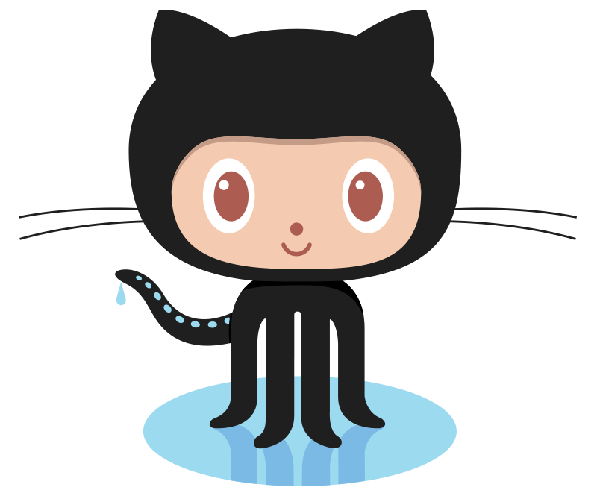
What is Git?
Notes:
Scope out how many people from the audience know Git/have it set up

Slide 12
What is Version Control?
Users can track changes to code
Allows developers to view older versions of their code
Infinitely useful for collaborative software development
Git is an example of a version control system
GitHub is one of many hosts for version control using Git

Slide 13
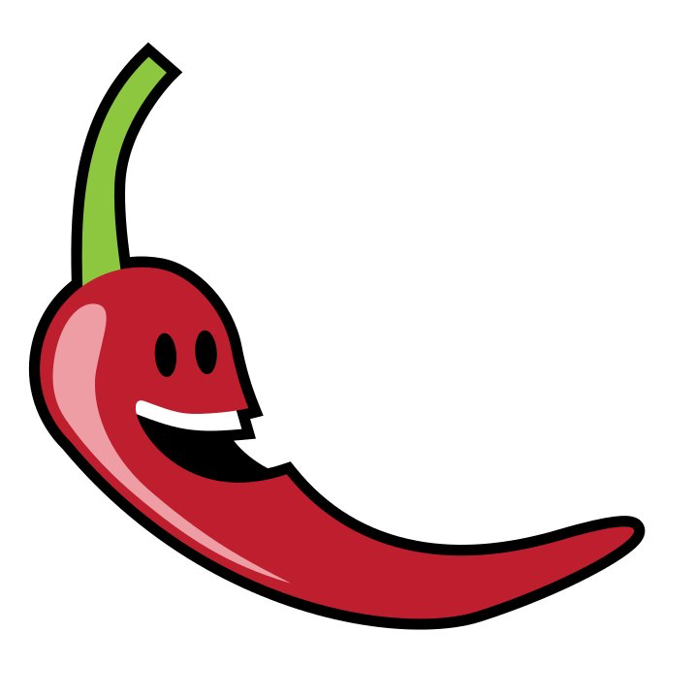
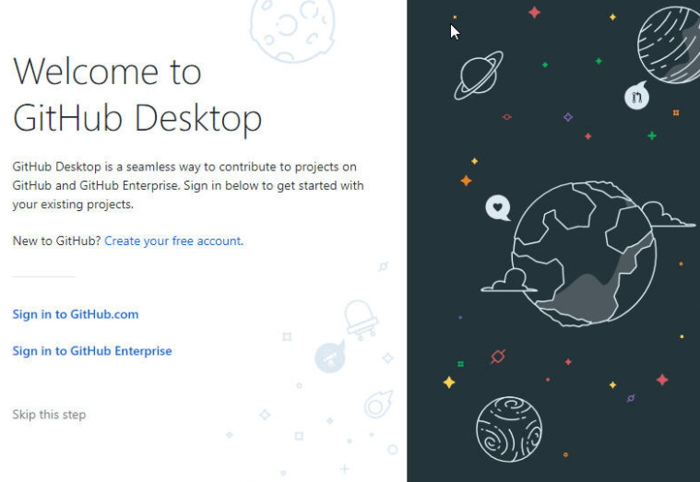

Setting Up GitHub
Create a GitHub account at: https://github.com/
After signing up, download the GitHub desktop client from:
https://desktop.github.com/
3. Follow the on-screen installation instructions
4. Sign-in to your GitHub account on the desktop client

Slide 14

Getting Ready

Slide 15
Setting Up Maven
Prerequisites:
Java 11
A Java IDE: Eclipse, IntelliJ, or NetBeans
Steps:
Mac OS | Windows 10
Make sure you have Homebrew installed (see https://brew.sh/) Open Terminal Type: brew install maven Restart your terminal Type mvn -v to verify your installation | Follow the instructions available at: https://bit.ly/2XeNtMA
Notes:
Maven is a build automation tool used for dependency management, and is very commonly seen in CI/CD pipelines (particularly in the Java world)

Slide 16
Setting Up Lombok
Lombok is a library for auto-generating code in Java!
In your IDE of choice, go to your plugins market
Search for “Lombok”
Install the plugin & restart your IDE
You’re good to go!
Notes:
Lombok specifically uses annotations to generate methods for you. It’s incredibly powerful, and in this project its most common use is the “@data” annotation
This annotation generates a no-argument constructor as well as all the getters & setters for the variables inside, and is used most often for DTOs

Slide 17
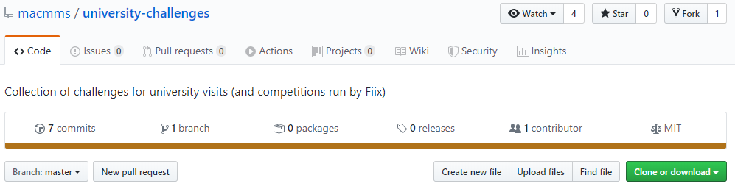
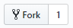
Downloading the Project
In your browser, navigate to https://github.com/macmms/university-challenges
Click the button at the top right of the page
In the GitHub Desktop client, search for ‘university-challenges’
Clone this repository
Take note of the local path that your repository was cloned to
Notes:
You’ll want to open the rpg-bot folder & load the project from the pom.xml file inside

Slide 18
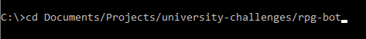
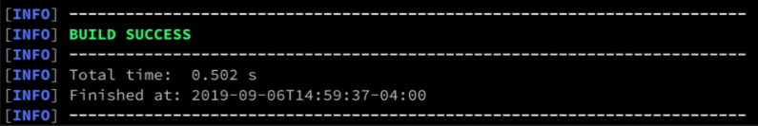
Compiling the Project
Open your Terminal (or Command Prompt)
Navigate to the path of you cloned the repository to using the cd command
Make sure you are in the rpg-bot directory
In your Terminal, run mvn clean install
Once it’s finished, you should see a message similar to this:

Slide 19
Figment of Fitecraft
Notes:
Introduce the challenge concept

Slide 20
Let the Games Begin!

Slide 21
Congratulations! You’re a tried and tested programmer.

